Slide 1
Programming Concept

Slide 2
Module Overview
In this Module, we will understand the following:
Annotations
Query Language
Criteria Queries
Native SQL
Caching
Batch Processing
Interceptors
Transaction Management

Slide 3
Annotations
Annotation is like Metadata To used for JAVA Source Code and read For Source Files.
Annotation used for mapping relational database and interacting with database.
Hibernate application can be created using many annotations such as @Entity, @Id, @Table etc.
Annotations in hibernate are based on the JPA 2 specification and supports all the features.
They are defined in the javax.persistence package. Hibernate EM(EntityManager) implements the interfaces & life cycle defined by the JPA specification.
We don't need to create mapping (hbm) if using Annotation as the annotations provide metadata.
Annotation Name | Description
@Entity | marks this class as an entity
@Id | marks the identifier for this entity
@Table | specifies the table name where data of this entity is to be persisted. Hibernate will use the class name as the table name by default, If you don't use @Table annotation,
@Column | specifies the details of the column for this property or field. Property name will be used as the column name by default, If @Column annotation is not specified,
Notes:
We will implement some of the implementation in up coming Demos of Native SQL.

Slide 4
Example: Annotations
For annotations we will refer second module i.e.Basic configurations slide no 47- Session example
package test.employee;
import javax.persistence.*;
@Entity
@Table(name = "Employee")
public class Employee {
@Id
@GeneratedValue
@Column(name = "id")
private int id;
@Column(name = "first_name")
private String firstName;
@Column(name = "last_name")
private String lastName;
@Column(name = "salary")
private int salary;
public Employee() {
// TODO Auto-generated constructor stub
}
public Employee(String fname, String lname, int salary) {
this.firstName = fname;
this.lastName = lname;
this.salary = salary;
}
public int getId() {
return id;
}
public void setId(int id) {
this.id = id;
}
public void setFirstName(String first_name) {
this.firstName = first_name;
}
public String getFirstName() {
return firstName;
}
public void setLastName(String last_name) {
this.lastName = last_name;
}
public String getLastName() {
return lastName;
}
public void setSalary(int salary) {
this.salary = salary;
}
public int getSalary() {
return salary;
}}

Slide 5
Cont..
Above Employee class uses standard JPA annotations.
@Entity marks Employee class as Entity Bean. @Table declares on which database Table this class will be mapped to. We can also use other attributes like catalog and schema along with name.
@Id marks the field(or group of fields) as primary key of entity. On the other hand, we can also specify how the primary key should be generated. It depends on the underlying database as well.
For example, on MySQL ,IDENTITY is supported (strategy = GenerationType.IDENTITY) declaration along with id column name but not on Oracle. On the other hand Oracle supports sequence (strategy = GenerationType.SEQUENCE) but MySQL doesn’t.
@Column maps the Employee class field to column name in database table. It is optional and if you have not specified , field name will be used as column name. Also we can specify other attributes including unique, nullable, name & length.
Notes:
Note that
@Table annotation is optional and in absence of this annotation, unqualified class name is used as table name in database.

Slide 6
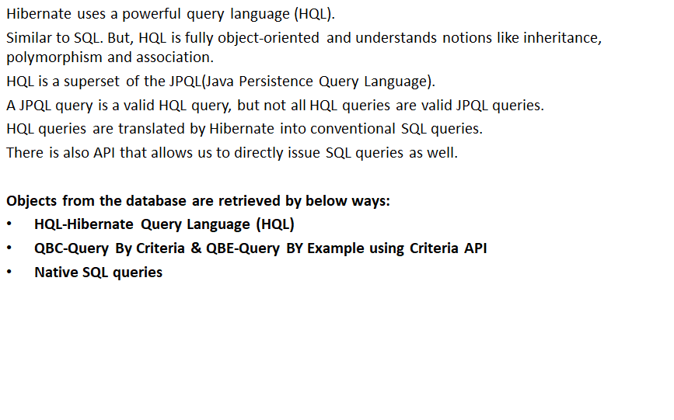
Hibernate Query Language(HQL)

Slide 7
Hibernate Query Language(HQL) Cont..
Update Statement
This alters the details of existing objects in the database.
In-memory entities, managed or not, will not get updated and wont -reflect changes resulting from issuing UPDATE statements. Example
Syntax
path – It is fully qualified name of the entity or entities
alias – This must be used when property names in the query
would otherwise be ambiguous.
It is used to abbreviate references to specific entities or their
Properties.
VERSIONED –update time stamps that are part of the entity
being updated.
property – properties of entities listed in the FROM path.
logicalExpression – a where clause.
Query query=session.createQuery("update Student set age=:age where studentId= :id ");
query.setInteger("age", 15);
query.setParameter(“id", “501");
int result=query.executeUpdate();
UPDATE [VERSIONED]
[FROM] path [[AS] alias] [, ...]
SET property = value [, ...]
[WHERE logicalExpression]
Here we are updating Student data with
hql update query multiple columns.

Slide 8
Hibernate Query Language(HQL) Cont..
Delete Statement
DELETE removes existing objects from the database. In-memory entities wont get updated to reflect changes resulting from DELETE statements. The Hibernate’s cascade rules will not be followed for deletions made.
The database will still remove the child rows, if we specify at the database level, cascading deletes either directly or through Hibernate, using the @OnDelete annotation.
Syntax
Example
DELETE
[FROM] path [[AS] alias]
[WHERE logicalExpression]
Query qr = session.createQuery("Delete Student where studentName = :id");
query.setParameter(":id", “501");
int result = query.executeUpdate();

Slide 9
Hibernate Query Language(HQL) Cont..
Insert Statement
This cannot be used to directly insert arbitrary entities.
Tt can only be used to insert entities constructed from information obtained from SELECT queries In case of general SQL, INSERT command inserts arbitrary data into a table, as well as insert values selected from other tables.
Syntax
Example
INSERT
INTO path ( property [, ...])
select
Query query = session.createQuery("insert into Student (student_code, student_name)" +"select student_code, student_name from student_info");
int result = query.executeUpdate();

Slide 10
Hibernate Query Language(HQL) Cont..
Select Statement
Used for querying the database for classes & their properties.
Example
Syntax
Retrieve a student detail where student ID is 501.
INSERT
INTO path ( property [, ...])
select
Query qr = session.createQuery("From Students where studentId= :id ");
query.setParameter("id", “501");
List list = query.list();

Slide 11
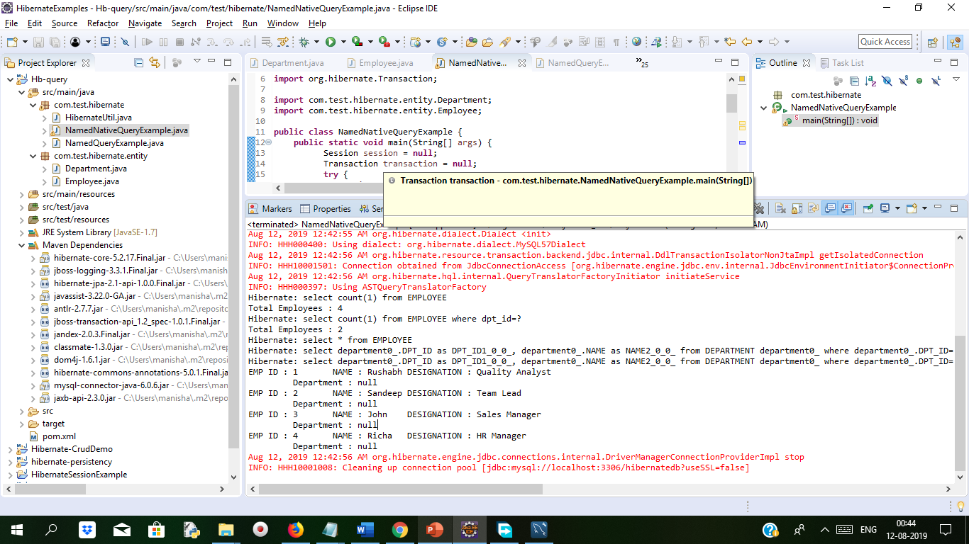
Demo: Query Language Duration 10 Min
Create Maven Project with Suitable Name add dependency as below
Pom.xml
<project xmlns="http://maven.apache.org/POM/4.0.0" xmlns:xsi="http://www.w3.org/2001/XMLSchema-instance" xsi:schemaLocation="http://maven.apache.org/POM/4.0.0 http://maven.apache.org/xsd/maven-4.0.0.xsd">
<modelVersion>4.0.0</modelVersion>
<groupId>HibernateQuery</groupId>
<artifactId>Hb-query</artifactId>
<version>0.0.1-SNAPSHOT</version>
<dependencies>
<dependency>
<groupId>org.hibernate</groupId>
<artifactId>hibernate-core</artifactId>
<version>5.2.17.Final</version>
</dependency>
<dependency>
<groupId>mysql</groupId>
<artifactId>mysql-connector-java</artifactId>
<version>6.0.6</version>
</dependency>
<dependency>
<groupId>javax.xml.bind</groupId>
<artifactId>jaxb-api</artifactId>
<version>2.3.0</version>
</dependency>
</dependencies>
</project>

Slide 12
Cont..
Create table Employee and Department in mysql and insert some values.
create table DEPARTMENT( DPT_ID int not null primary key, NAME varchar(100) not null);
create table EMPLOYEE( EMP_ID int not null primary key, NAME varchar(100) not null, DESIGNATION varchar(100), DPT_ID int, foreign key (DPT_ID) references DEPARTMENT(DPT_ID));
insert into DEPARTMENT(DPT_ID,NAME) values(1,'Quality Analysis’);
insert into DEPARTMENT(DPT_ID,NAME) values(2,'Finance’);
insert into EMPLOYEE(EMP_ID,NAME,DESIGNATION,DPT_ID) values(1,'Rushabh','Quality Analyst',1);
insert into EMPLOYEE(EMP_ID,NAME,DESIGNATION,DPT_ID) values(2,'Sandeep','Team Lead',1);
insert into EMPLOYEE(EMP_ID,NAME,DESIGNATION,DPT_ID) values(3,'John','Sales Manager',2);
insert into EMPLOYEE(EMP_ID,NAME,DESIGNATION,DPT_ID) values(4,'Richa','HR Manager',2);

Slide 13
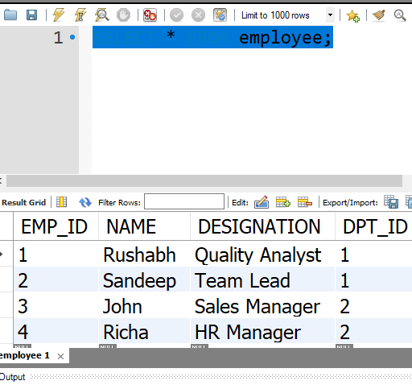
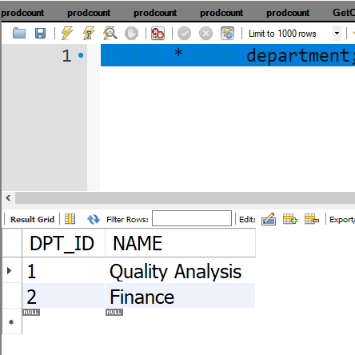
Cont..
After inserting values in both the table it will look like Employee table and department table

Slide 14
Cont..
@Column(name = "NAME")
private String name;
@OneToMany(cascade = CascadeType.ALL, mappedBy = "department")
private List<Employee> employees = new ArrayList<>();
public void setName(String name)
{
this.name=name;
}
public String getName() {
return name;
}
public void setId(int id)
{
this.id=id;
}
public int getId() {
return id;
}}
Create Department class which has matching entity with database table
package com.test.hibernate.entity;
import java.util.*;
import javax.persistence.*;
@Entity
@Table(name="DEPARTMENT")
//Using @NamedQuery for single JPQL or HQL
@NamedQuery(name="get_total_dept", query="select count(1) from Department")
//Using @NamedQueries for multiple JPQL or HQL
@NamedQueries({
@NamedQuery(name="get_dept_name_by_id", query="select name from Department where id=:id"),
@NamedQuery(name="get_all_dept", query="from Department")
})
public class Department {
@Id
@Column(name = "DPT_ID")
private int id;
We have created an @Entity class and annotated it with the @NamedQuery and @NamedQueries annotation for using single or multiple named HQL/JPQL query expression

Slide 15
Cont..
package com.test.hibernate.entity;
import javax.persistence.*;
@Entity
@Table(name = "EMPLOYEE")
// Using @NamedNativeQuery for single native sql query
@NamedNativeQuery(name = "get_total_emp", query = "select count(1) from EMPLOYEE")
// Using @NamedNativeQuery for multiple native sql queries
@NamedNativeQueries({
// Using @NamedNativeQuery with parameter binding
@NamedNativeQuery(name = "get_total_emp_by_dept", query = "select count(1) from EMPLOYEE where dpt_id=:did"),
@NamedNativeQuery(name = "get_all_emp", query = "select * from EMPLOYEE",resultClass=Employee.class)
})
public class Employee {
@Id
@Column(name = "EMP_ID")
private int id;
@Column(name = "NAME")
private String name;
@Column(name = "DESIGNATION")
private String designation;
@ManyToOne
@JoinColumn(name = "DPT_ID")
private Department department;
public void setId(int id)
{
this.id=id;
}
public int getId() {
// TODO Auto-generated method stub
return id;
}
public Department getDepartment() {
// TODO Auto-generated method stub
return department;
}
public void setName(String name)
{
this.name=name;
}
public String getName() {
// TODO Auto-generated method stub
return name;
}

Slide 16
Contd..
public void setDesignation(String designation)
{
this.designation=designation;
}
public String getDesignation() {
// TODO Auto-generated method stub
return designation;
}}
import com.test.hibernate.entity.Department;
import com.test.hibernate.entity.Employee;
public class HibernateUtil {
private static StandardServiceRegistry registry;
private static SessionFactory sessionFactory;
public static SessionFactory getSessionFactory() {
if (sessionFactory == null) {
try {
StandardServiceRegistryBuilder registryBuilder = new StandardServiceRegistryBuilder();
//Configuration properties
Map<String, Object> settings = new HashMap<>();
settings.put(Environment.DRIVER, "com.mysql.cj.jdbc.Driver");
settings.put(Environment.URL, "jdbc:mysql://localhost:3306/hibernatedb?useSSL=false");
settings.put(Environment.USER, "root");
settings.put(Environment.PASS, "root");
settings.put(Environment.HBM2DDL_AUTO, "validate");
settings.put(Environment.SHOW_SQL, true);
HibernateUtil.java which has database connection methods.
package com.test.hibernate;
import java.util.HashMap;
import java.util.Map;
import org.hibernate.SessionFactory;
import org.hibernate.boot.Metadata;
import org.hibernate.boot.MetadataSources;
import org.hibernate.boot.registry.StandardServiceRegistry;
import org.hibernate.boot.registry.StandardServiceRegistryBuilder;
import org.hibernate.cfg.Environment;

Slide 17
Cont..
registryBuilder.applySettings(settings);
registry = registryBuilder.build();
MetadataSources sources = new MetadataSources(registry);
sources.addAnnotatedClass(Department.class);
sources.addAnnotatedClass(Employee.class);
Metadata metadata = sources.getMetadataBuilder().build();
sessionFactory = metadata.getSessionFactoryBuilder().build();
} catch (Exception e) {
if (registry != null) {
StandardServiceRegistryBuilder.destroy(registry);
}
e.printStackTrace();
}
}
return sessionFactory;
}
public static void shutdown() {
if (registry != null) {
StandardServiceRegistryBuilder.destroy(registry);
} }}

Slide 18
Cont..
package com.test.hibernate;
import java.util.List;
import org.hibernate.Session;
import org.hibernate.Transaction;
import com.test.hibernate.entity.Department;
public class NamedQueryExample {
public static void main(String[] args) {
Session session = null;
Transaction transaction = null;
try {
session = HibernateUtil.getSessionFactory().openSession();
transaction = session.beginTransaction();
List<Long> totalDept=session.createNamedQuery("get_total_dept",Long.class).getResultList();
System.out.println("Total Department: "+totalDept.get(0));
List<String> deptName=session.createNamedQuery("get_dept_name_by_id",String.class)
.setParameter("id", 2)
.getResultList();
for (Object object : deptName) {
System.out.println(object);
}
List<Department> departments=session.createNamedQuery("get_all_dept",
Department.class)
.getResultList();
for (Department department : departments) {
System.out.println("ID : "+department.getId()+" \tNAME : "+department.getName());
}
transaction.commit();
} catch (Exception e) {
e.printStackTrace();
} finally {
if (session != null) {
session.close();
}
}
HibernateUtil.shutdown();
}
}
The above NamedQueryExample will create object of dept and session object will call createdNamedQuery() method to get the result of total department columns

Slide 19
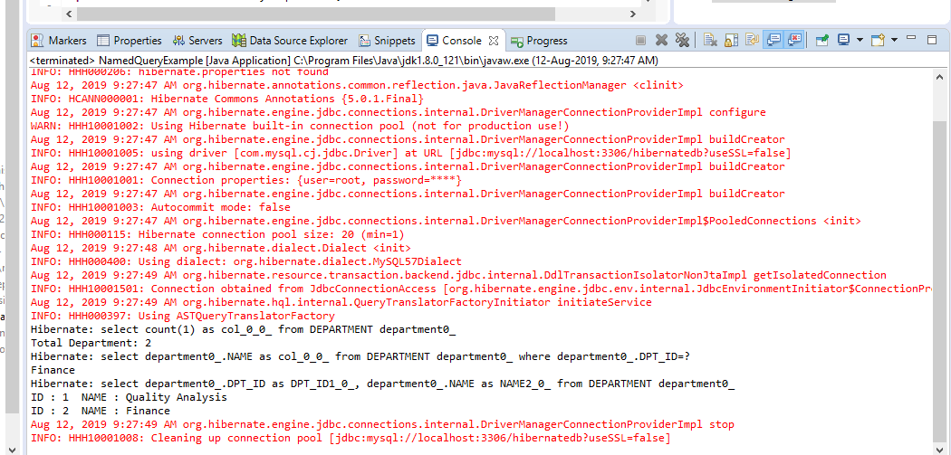
Cont..
After executing NamedQueryExample.java file we get following output.

Slide 20
Criteria Queries
Thera are 3 different ways to pull DB data. HQL & Native SQL is discussed and we are left with hibernate criteria queries.
Using this the query expressions can be more structures & also supports to check the syntax at compile-time unlike HQL or SQL.
The example objects can be supplied with required properties using QBE .
It also includes projection and aggregation methods, including count().
We can build a criteria query object programmatically; by using the org.hibernate.Criteria and pass the class of persistent object or its entity name to the createCriteria() method.
Persistence object’s class instance is retrieved as a criteria query is executed.

Slide 21
Cont..
For instance – a criteria query with no optional parameters or restrictions is simple one & returns every object to the associated class.
Criteria ct = session.createCriteria(Services.class);
List<Services> results = ct.list();
Hibernate criteria – using Restrictions
Query restrictions are applied to choose which objects to be retrieved; for instance, services with a cost above $3000.
The add() method takes an org.hibernate.criterion.Criterion object that represents an single restriction. There can be multiple restriction for a criteria query.
Restrictions.eq() Example
Criteria ct = session.createCriteria(Services.class);
ct.add(Restrictions.eq("description",“Training"));
List<Services> results = ct.list()
Restrictions.like() and Restrictions.ilike() example
NO need of searching for exact matches, its possible to get all objects with property matching part of a given pattern. For this, we need to form an SQL LIKE clause, with either the like() or the ilike() method. The ilike() method is case-insensitive.
Criteria ct = session.createCriteria(Services.class);
ct.add(Restrictions.like("name",“Train%",MatchMode.ANYWHERE));
List<Services> results = ct.list();

Slide 22
Cont..
Restrictions.isNull() and Restrictions.isNotNull() example
The isNull() and isNotNull() restrictions allow you to do a search for objects that have (or do not have) null property values.
Criteria ct = session.createCriteria(Services.class);
ct.add(Restrictions.isNull("name"));
List<Services> results = ct.list();
Restrictions.gt(), Restrictions.ge(), Restrictions.lt() and Restrictions.le() examples
Restrictions are useful for doing math comparisons.
greater-than comparison =gt(),
greater-than-or-equal-to comparison = ge(),
less-than comparison = lt(),
less-than-or-equal-to comparison = le().
Lets see a quick retrieval of all services with prices over $3000 like this, relying on Java’s type promotions to handle the conversion to Double:
Criteria ct = session.createCriteria(Services.class);
ct.add(Restrictions.gt("price", $3000.0));
List<Services> results = ct.list();

Slide 23
Native SQL
Hibernate provide option to execute native SQL queries using SQLQuery object. Hibernate SQL Query is very handy when we execute database vendor specific queries that are not supported by Hibernate API.
For instance query hints or the CONNECT keyword in Oracle Database.
By using Native SQL, select, non-select operations can be performed on the data
Native SQL means using the direct SQL command specific to the current database and executing it with using hibernate
Advantages of Native SQL
We can use the database specific keywords, commands , to retrieve the data from the database
While migrating a JDBC program into hibernate, the task becomes very easy as JDBC uses direct SQL commands and hibernate also supports the same commands by using this Native SQL
Disadvantage of Native SQL
the hibernate application becomes dependent on database.

Slide 24
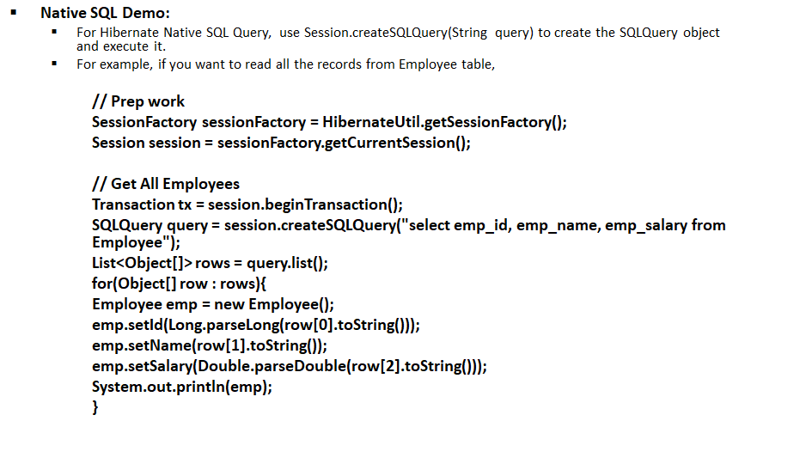
Native SQL Cont..

Slide 25
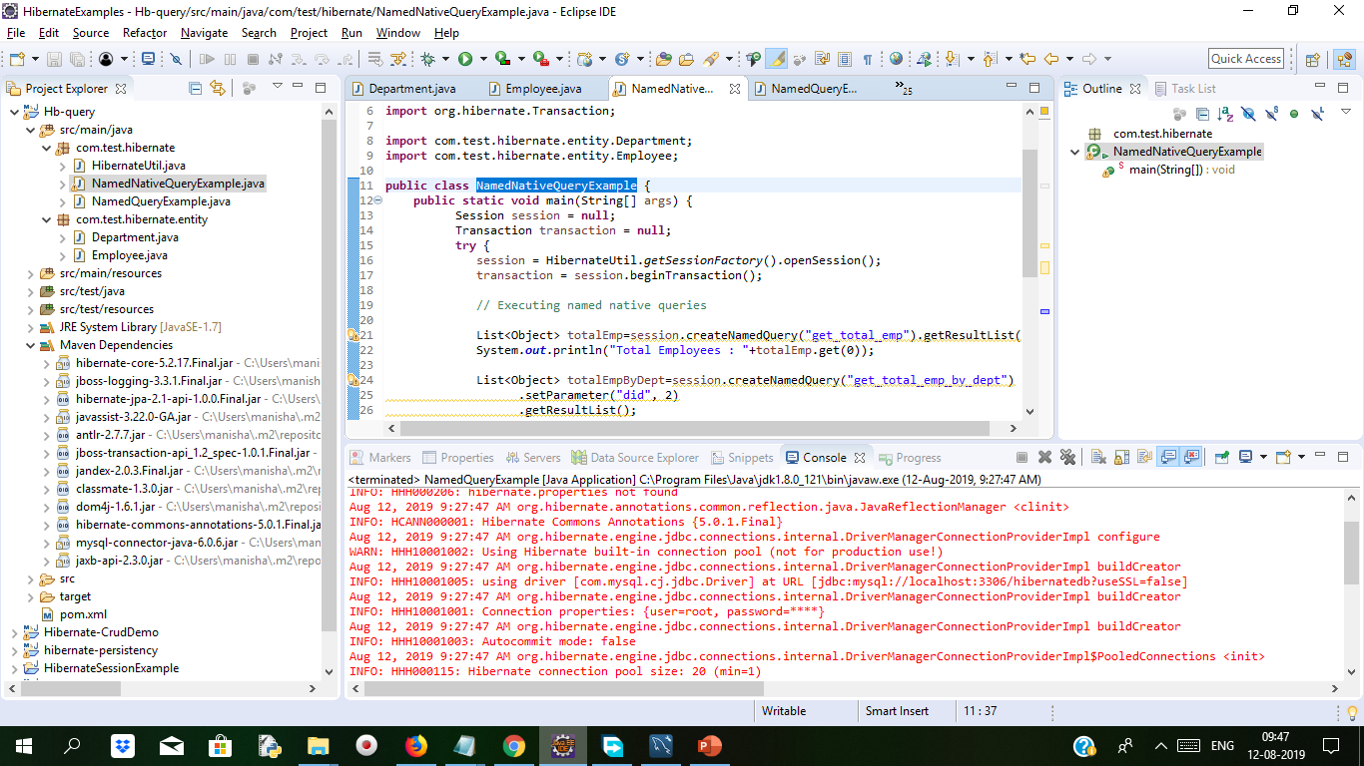
Demo: Native Sql Duration: 10 min
For understanding example of NativeSql, we will see the same example which we executed in last slide i.e. slide no 19. The only difference is that we will add new class NamedNativeQueryExample.java to see how native sql works. The project structure will be same and the table which are used will be same also department,Employee class design, HibernateUtil class will be same

Slide 26
Demo: Native Sql Cont..
NamedNativeQueryExample.java
package com.test.hibernate;
import java.util.List;
import org.hibernate.Session;
import org.hibernate.Transaction;
import com.test.hibernate.entity.Department;
import com.test.hibernate.entity.Employee;
public class NamedNativeQueryExample {
public static void main(String[] args) {
Session session = null;
Transaction transaction = null;
try {
session = HibernateUtil.getSessionFactory().openSession();
transaction = session.beginTransaction();
// Executing named native queries
List<Object> totalEmp=session.createNamedQuery("get_total_emp").getResultList();
System.out.println("Total Employees : "+totalEmp.get(0));
List<Object> totalEmpByDept=session.createNamedQuery("get_total_emp_by_dept").
setParameter("did", 2).getResultList();
System.out.println("Total Employees : "+totalEmpByDept.get(0));
List<Employee> employees=session.createNamedQuery("get_all_emp",Employee.class)
.getResultList();
for (Employee employee : employees) {
System.out.println("EMP ID : "+employee.getId()+"\t NAME : "+employee.getName()+"\tDESIGNATION : "+employee.getDesignation());
Department department=employee.getDepartment();
System.out.println("\t Department : "+department.getName());
}
transaction.commit();
} catch (Exception e) {
e.printStackTrace();
} finally {
if (session != null) {
session.close();
}
}
HibernateUtil.shutdown();
}}

Slide 27
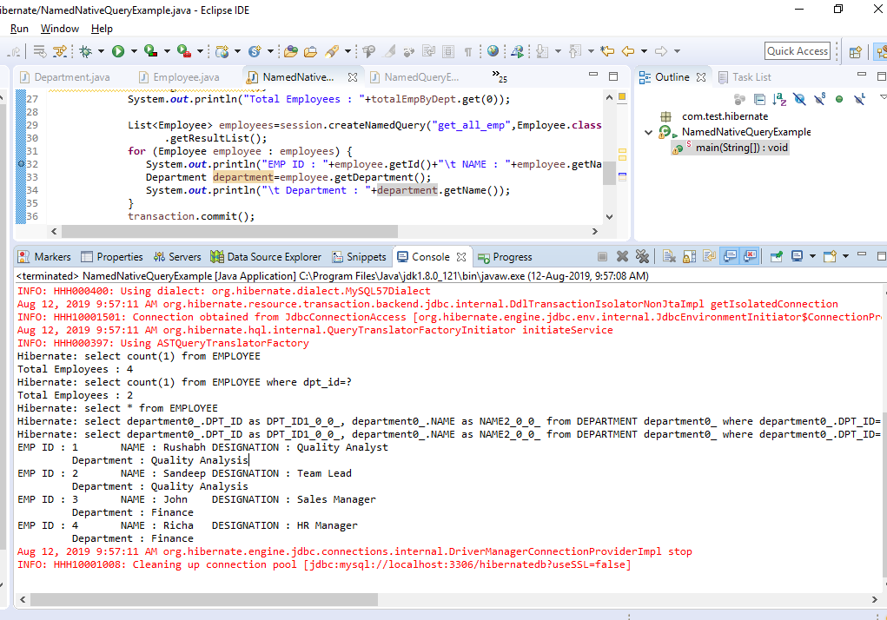
Demo: Native Sql Cont..
After Running NamedNativeQueryExample The program we can see the following output

Slide 28
Caching
Caching is designed to lower the amount of database access. When the objects that are cached reside in memory, its flexible to limit the usage of memory and store the items in disk storage. The implementation will depend on the underlying cache manager. There are various flavors of caching existing, but best is to cache non-transactional and read-only data.
It enhances the performance of a system. It is a buffer memory that lies between the application and the database. Cache memory stores recently used data items in order to reduce the number of database hits as much as possible.
Hibernate Cache can be very useful in gaining fast application performance if used correctly. The main motive is to reduce the number of database queries, hence reducing the throughput time of the application.
The advantage of cache mechanism is, whenever again we want to load the same object from the database then instead of hitting the database once again, it loads from the local cache memory only, so that the number of round trips between an application and a database server gets reduced.

Slide 29
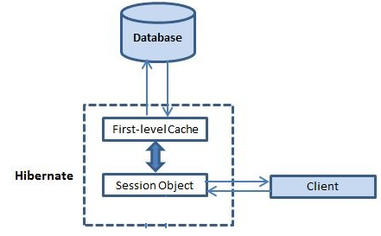
Caching Cont..
In hibernate we have two levels of caching
First Level Cache [ or ] Session Cache
Second Level Cache [ or ] Session Factory Cache [ or ] JVM Level Cache (Second level cache which was introduced in hibernate 3.0)
Associated With Session Object
Store Database Query

Slide 30
Demo: Caching Duration: 10 mins
First-level cache is by default in hibernate and second-level cache is optional.
If the session factory is alive, the second level cache will exist.
All properties and associations data of individual entities are cached by second level cache.
EhCache and OSCache providers provide second level chaching.
Disable the second level of cache by updating this in the hibernate configuration file (hibernate.cfg.xml)
Enable the second level of cache by updating this in the hibernate configuration file (hibernate.cfg.xml)
<property name="cache.use_second_level_cache">true</property>
<property name="cache.provider_class">org.hibernate.cache.EhCacheProvider</property>
<property name="cache.provider_class">org.hibernate.cache.NoCacheProvider</property>

Slide 31
Demo: Caching contd..
To understand how hibernate works with cache we will create the New Java Project and add Employee and Address Classes to com.test.hibernate.model package.
The Employee and Address Classes will have Employe and Address table’s columns mapping
Address Class annotation as below.
@Entity
@Table(name = "ADDRESS")
@Id
@Column(name = "emp_id", unique = true, nullable = false)
etc..
Employee Class annotation
@Entity
@Table(name = "EMPLOYE")
@Column(name = "emp_id")
etc…
The above annotation will match the respective tables column from database.

Slide 32
Demo: Caching contd..
Create table Employe and Address table in Mysql test database
CREATE TABLE `Employe` ( `emp_id` int(11) unsigned NOT NULL AUTO_INCREMENT, `emp_name` varchar(20) NOT NULL, `emp_salary` double(10,0) NOT NULL DEFAULT '0', PRIMARY KEY (`emp_id`)) ENGINE=InnoDB AUTO_INCREMENT=1 DEFAULT CHARSET=utf8;
CREATE TABLE `Address` ( `emp_id` int(11) unsigned NOT NULL, `address_line1` varchar(50) NOT NULL DEFAULT '', `zipcode` varchar(10) DEFAULT NULL, `city` varchar(20) DEFAULT NULL, PRIMARY KEY (`emp_id`), CONSTRAINT `emp_fk_1` FOREIGN KEY (`emp_id`) REFERENCES `Employe` (`emp_id`)) ENGINE=InnoDB DEFAULT CHARSET=utf8;
Insert some rows in Employe and Address
INSERT INTO `Employe` (`emp_id`, `emp_name`, `emp_salary`)VALUES (111, 'Neha', 10000), (112, 'Dixita', 12200), (113, 'Ragini', 30099), (114, 'Madhur', 45000);
INSERT INTO `Address` (`emp_id`, `address_line1`, `zipcode`, `city`)VALUES (111, '2/4 Nehru Road', 411011’, 'Pune'), (112, 'Ekta Avenue', 400047', 'Santa Cruz'), (113, 'Nilkanth Society', 411011', 'Pune'), (114, 'Sagar Palace', '430008', ' ');

Slide 33
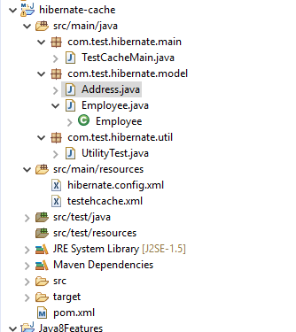
Demo: Caching contd..
Create a new Maven Project and add the dependency
For this example We have added following dependencies.
<project xmlns="http://maven.apache.org/POM/4.0.0" xmlns:xsi="http://www.w3.org/2001/XMLSchema-instance" xsi:schemaLocation="http://maven.apache.org/POM/4.0.0 http://maven.apache.org/xsd/maven-4.0.0.xsd">
<modelVersion>4.0.0</modelVersion>
<groupId>com.test.hibernatcache</groupId>
<artifactId>hibernate-cache</artifactId>
<version>0.0.1-SNAPSHOT</version>
<dependencies>
<dependency>
<groupId>org.hibernate</groupId>
<artifactId>hibernate-core</artifactId>
<version>4.3.5.Final</version>
</dependency>
<dependency>
<groupId>mysql</groupId>
<artifactId>mysql-connector-java</artifactId>
<version>5.0.5</version>
</dependency>
</dependencies>
</project>

Slide 34
Demo: Caching Cont..
Address.java file as below
package com.test.hibernate.model;
import javax.persistence.Column;
import javax.persistence.Entity;
import javax.persistence.GeneratedValue;
import javax.persistence.Id;
import javax.persistence.OneToOne;
import javax.persistence.PrimaryKeyJoinColumn;
import javax.persistence.Table;
import org.hibernate.annotations.GenericGenerator;
import org.hibernate.annotations.Parameter;
@Entity
@Table(name = "ADDRESS")
public class Address {
@Id
@Column(name = "emp_id", unique = true, nullable = false)
@GeneratedValue(generator = "gen")
@GenericGenerator(name = "gen", strategy = "foreign",
parameters = { @Parameter(name = "property", value = "employee") })
private long id;
@Column(name = "address_line1")
private String addressLine1;
@Column(name = "zipcode")
private String zipcode;
@Column(name = "city")
private String city;
@OneToOne
@PrimaryKeyJoinColumn
private Employee employee;
public long getId() {
return id;
}
public void setId(long id) {
this.id = id;
}
public String getAddressLine1() {
return addressLine1;
}
public void setAddressLine1(String addressLine1) {
this.addressLine1 = addressLine1;
}
public String getZipcode() {
return zipcode;
}
public void setZipcode(String zipcode) {
this.zipcode = zipcode;
}
public String getCity() {
return city;
}
public void setCity(String city) {
this.city = city;
}
public Employee getEmployee() {
return employee;
}
public void setEmployee(Employee employee) {
this.employee = employee;
}
}
Notes:
@GeneratedValue will fetch the generated value. @GenericGenerator annotation enables to map a user defined sequence generator with our hibernate session of application.
The @GeneratedValue annotation denotes that a column value, which must be annotated with @Id is generated.
4 values for the strategy element on the @GeneratedValue annotation are:
1)IDENTITY
2)AUTO
3)TABLE
4)SEQUENCE.

Slide 35
Caching Example contd.
Employee.java
package com.test.hibernate.model;
import javax.persistence.Column;
import javax.persistence.Entity;
import javax.persistence.GeneratedValue;
import javax.persistence.GenerationType;
import javax.persistence.Id;
import javax.persistence.OneToOne;
import javax.persistence.Table;
import org.hibernate.annotations.Cascade;
@Entity
@Table(name = "EMPLOYE")
public class Employee {
@Id
@GeneratedValue(strategy = GenerationType.IDENTITY)
@Column(name = "emp_id")
private long id;
@Column(name = "emp_name")
private String name;
@Column(name = "emp_salary")
private double salary;
@OneToOne(mappedBy = "employee")
@Cascade(value = org.hibernate.annotations.CascadeType.ALL)
private Address address;
public long getId() {
return id;
}
public void setId(long id) {
this.id = id;
}
public Address getAddress() {
return address;
}
public void setAddress(Address address) {
this.address = address;
}
public String getName() {
return name;
}
public void setName(String name) {
this.name = name;
}
public double getSalary() {
return salary;
}
public void setSalary(double salary) {
this.salary = salary;
}
}
Notes:
The Employee class file will have properties i.e. attributes of Employee class corresponding to Employe table This example uses one to one mapping so we used @OneToOne annotation

Slide 36
Caching Example
UtilityTest.java file
package com.test.hibernate.util;
import org.hibernate.SessionFactory;
import org.hibernate.boot.registry.StandardServiceRegistryBuilder;
import org.hibernate.cfg.Configuration;
import org.hibernate.service.ServiceRegistry;
public class UtilityTest {
private static SessionFactory sessionFactory;
private static SessionFactory buildSessionFactory() {
try {
// Create the SessionFactory from hibernate.cfg.xml
Configuration configuration = new Configuration();
configuration.configure("hibernate.config.xml");
System.out.println("Hibernate Configuration loaded");
ServiceRegistry serviceRegistry = new StandardServiceRegistryBuilder().applySettings(configuration.getProperties()).build();
System.out.println("Hibernate serviceRegistry created");
SessionFactory sessionFactory = configuration.buildSessionFactory(serviceRegistry);
return sessionFactory;
}
catch (Throwable ex) {
System.err.println("Initial SessionFactory creation failed." + ex);
ex.printStackTrace();
throw new ExceptionInInitializerError(ex);
}
}
public static SessionFactory getSessionFactory() {
if(sessionFactory == null) sessionFactory = buildSessionFactory();
return sessionFactory;
}
}

Slide 37
Caching Example
Hibernate.config.xml file
<?xml version="1.0" encoding="UTF-8"?>
<!DOCTYPE hibernate-configuration PUBLIC
"-//Hibernate/Hibernate Configuration DTD 3.0//EN"
"http://hibernate.org/dtd/hibernate-configuration-3.0.dtd">
<hibernate-configuration>
<session-factory>
<property name="hibernate.connection.driver_class">com.mysql.jdbc.Driver</property>
<property name="hibernate.connection.password">root</property>
<property name="hibernate.connection.url">jdbc:mysql://localhost/test</property>
<property name="hibernate.connection.username">root</property>
<property name="hibernate.dialect">org.hibernate.dialect.MySQLDialect</property>
<property name="hibernate.current_session_context_class">thread</property>
<property name="hibernate.show_sql">true</property>
<mapping class="com.test.hibernate.model.Employee"/>
<mapping class="com.test.hibernate.model.Address"/>
</session-factory>
</hibernate-configuration>
The hibernate-ehcache artifact has a dependency on the Ehcache implementation itself, also it is transitively included in the classpath.
Testehcache.xml
<?xml version="1.0" encoding="UTF-8"?>
<ehcache xmlns:xsi="http://www.w3.org/2001/XMLSchema-instance"
xsi:noNamespaceSchemaLocation="ehcache.xsd" updateCheck="true"
monitoring="autodetect" dynamicConfig="true">
<diskStore path="java.io.tmpdir/ehcache" />
<defaultCache maxEntriesLocalHeap="10000" eternal="false"
timeToIdleSeconds="120" timeToLiveSeconds="120" diskSpoolBufferSizeMB="30"
maxEntriesLocalDisk="10000000" diskExpiryThreadIntervalSeconds="120"
memoryStoreEvictionPolicy="LRU" statistics="true">
<persistence strategy="localTempSwap" />
</defaultCache>
<cache name="employe" maxEntriesLocalHeap="10000" eternal="false"
timeToIdleSeconds="5" timeToLiveSeconds="10">
<persistence strategy="localTempSwap" />
</cache>
<cache name="org.hibernate.cache.internal.StandardQueryCache"
maxEntriesLocalHeap="5" eternal="false" timeToLiveSeconds="120">
<persistence strategy="localTempSwap" />
</cache>
<cache name="org.hibernate.cache.spi.UpdateTimestampsCache"
maxEntriesLocalHeap="5000" eternal="true">
<persistence strategy="localTempSwap" />
</cache>
</ehcache>
Notes:
Note: For debugging we can disable second-level caching, set hibernate.cache.use_second_level_cache property to false.

Slide 38
Caching Example
MainApp.java file
package com.test.hibernate.main;
import org.hibernate.Session;
import org.hibernate.SessionFactory;
import org.hibernate.Transaction;
import org.hibernate.stat.Statistics;
import com.test.hibernate.model.Employee;
import com.test.hibernate.util.UtilityTest;
public class TestCacheMain {
public static void main(String[] args) {
System.out.println("Temp Dir:"+System.getProperty("java.io.tmpdir"));
//Initialize Sessions
SessionFactory sessionFactory = UtilityTest.getSessionFactory();
Statistics stats = sessionFactory.getStatistics();
System.out.println("Stats enabled="+stats.isStatisticsEnabled());
stats.setStatisticsEnabled(true);
System.out.println("Stats enabled="+stats.isStatisticsEnabled());
Session session = sessionFactory.openSession();
Session otherSession = sessionFactory.openSession();
Transaction transaction = session.beginTransaction();
Transaction otherTransaction = otherSession.beginTransaction();
printStats(stats, 0);
Employee emp = (Employee) session.load(Employee.class, 1L);
printData(emp, stats, 1);
emp = (Employee) session.load(Employee.class, 1L);
printData(emp, stats, 2);
//clear first level cache, so that second level cache is used
session.evict(emp); this method remove employee object from first level cache
emp = (Employee) session.load(Employee.class, 1L);
printData(emp, stats, 3);
emp = (Employee) session.load(Employee.class, 3L);
printData(emp, stats, 4);
emp = (Employee) otherSession.load(Employee.class, 1L);
printData(emp, stats, 5);
//Release resources
transaction.commit();
otherTransaction.commit();
sessionFactory.close();
}
private static void printStats(Statistics stats, int i) {
System.out.println("***** " + i + " *****");
System.out.println("Fetch Count="
+ stats.getEntityFetchCount());
System.out.println("Second Level Hit Count="
+ stats.getSecondLevelCacheHitCount());
System.out
.println("Second Level Miss Count="
+ stats
.getSecondLevelCacheMissCount());
System.out.println("Second Level Put Count="
+ stats.getSecondLevelCachePutCount());
}
private static void printData(Employee emp, Statistics stats, int count) {
System.out.println(count+":: Name="+emp.getName()+", Zipcode="+emp.getAddress().getZipcode());
printStats(stats, count);
}}
Notes:
SessionFactory sessionFactory = UtilityTest.getSessionFactory();
Session session = sessionFactory.openSession();
Here we are reading hibernate.cfg.xml.
evict() method will remove the employee object from the first level cache, If we try to load it, hibernate finds the object in the second level cache.

Slide 39
Caching Example
After running mainApp we get below output:
Temp Dir:C:\Users\[username]\AppData\Local\Temp\
Hibernate Configuration loaded
Hibernate serviceRegistry created
Stats enabled=false
Stats enabled=true
***** 0 *****
Fetch Count=0
Second Level Hit Count=0
Second Level Miss Count=0
Second Level Put Count=0
Hibernate: select employee0_.emp_id as emp_id1_1_0_, employee0_.emp_name as emp_name2_1_0_, employee0_.emp_salary as emp_sala3_1_0_, address1_.emp_id as emp_id1_0_1_, address1_.address_line1 as address_2_0_1_, address1_.city as city3_0_1_, address1_.zipcode as zipcode4_0_1_ from EMPLOYE employee0_ left outer join ADDRESS address1_ on employee0_.emp_id=address1_.emp_id where employee0_.emp_id=?

Slide 40
Caching Example
1:: Name=Neha, Zipcode=411011
***** 1 *****
Fetch Count=1
Second Level Hit Count=0
Second Level Miss Count=1
Second Level Put Count=2
2:: Name=Neha, Zipcode=411011
***** 2 *****
Fetch Count=1
Second Level Hit Count=0
Second Level Miss Count=1
Second Level Put Count=2
3:: Name=Neha, Zipcode=411011
***** 3 *****
Fetch Count=1
Second Level Hit Count=2
Second Level Miss Count=1
Second Level Put Count=2
Hibernate: select employee0_.emp_id as emp_id1_1_0_, employee0_.emp_name as emp_name2_1_0_, employee0_.emp_salary as emp_sala3_1_0_, address1_.emp_id as emp_id1_0_1_, address1_.address_line1 as address_2_0_1_, address1_.city as city3_0_1_, address1_.zipcode as zipcode4_0_1_ from EMPLOYEE employee0_ left outer join ADDRESS address1_ on employee0_.emp_id=address1_.emp_id where employee0_.emp_id=?
4:: Name= Dixita, Zipcode= 400047
***** 4 *****
Fetch Count=2
Second Level Hit Count=2
Second Level Miss Count=2
Second Level Put Count=4
5:: Name=Neha, Zipcode=411011
***** 5 *****
Fetch Count=2
Second Level Hit Count=4
Second Level Miss Count=2
Second Level Put Count=4
Notes:
As we saw from output, at first statistics were disabled and later but we enabled it just to check our hibernate second level cache.
Query Cache. Query Cache is used to cache the results of a query.
Demo Explanation:
All counts are 0 at start
Employee id 111 firsts get loaded.
First Level caching gets scanned then move to Second Level
If no object in cache, DB fires query & count becomes 1
The object once loaded gets saved in both 1st & 2nd level cache.
Employee object also comprises of Address so we can find that put count is 2, so both the objects are saved into second level cache and count is increasing to 2.
Employee is 111 firsts get loaded & present in 1st Level Cache. No DB query & 2nd Level Cache Count remains same.
When loaded in another session, employee id 111 is found in 2nd level cache as it is pertained across sessions in hibernate.
No DB query is triggered here.
Fetch count, miss count and put count variables value remains same whereas hit count increases from 2 to 4.
When tried with another Employee id, database query is executed and fetch count increases to 2, miss count increases from 1 to 2 and put count gets increased from 2 to 4.

Slide 41
Batch Processing
Hibernate Batch processing is an easy way to add multiple statements into a batch and execute that batch by making a single round trip to the database.
Here we will learn how to create batch insert and batch update statements using JPA and Hibernate.
JDBC offers support for Batching together SQL statements that can be represented as a single Prepared Statement.
For an enterprise application, we have the front-end system for OLTP (Online Transaction Processing) traffic, and another server for batch processors which are used for ETL (Extract, Transform, Load) purposes.
The batch processor splits the data to be processed into several chunks, therefore offering the following advantages:
each chunk can be processed by a separate working thread, which increases throughput and speeds the processing time
each chunk can use its own database transaction, so, if there is a failure, just the current transaction changes not all.

Slide 42
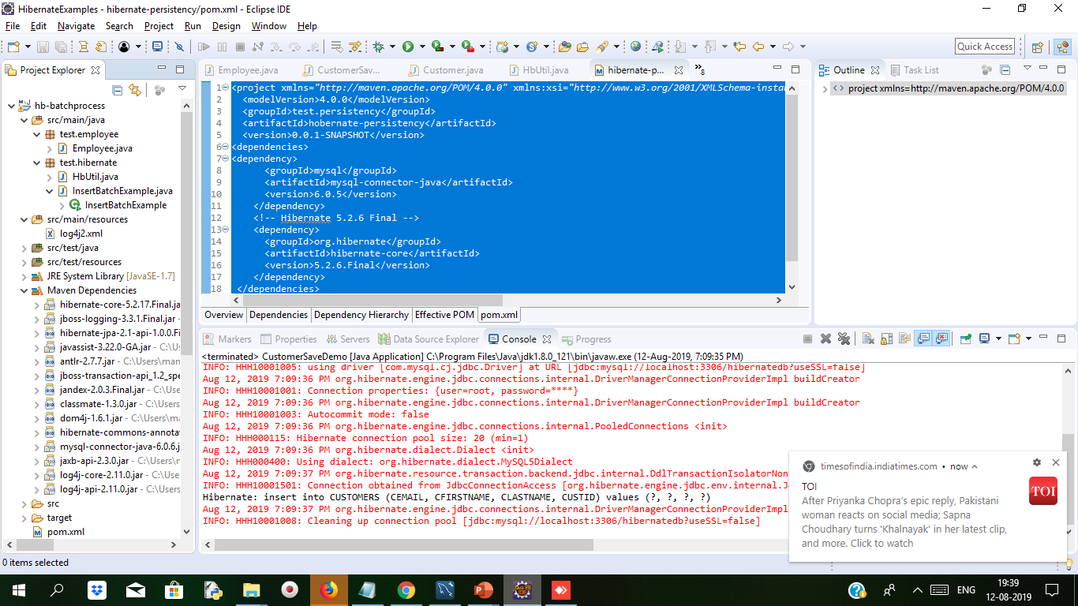
Demo: Batch Processing Duration: 20 Mins
create a Java based Maven project with Eclipse. In Eclipse IDE, go to File -> New -> Maven Project.
<project xmlns="http://maven.apache.org/POM/4.0.0" xmlns:xsi="http://www.w3.org/2001/XMLSchema-instance" xsi:schemaLocation="http://maven.apache.org/POM/4.0.0 http://maven.apache.org/xsd/maven-4.0.0.xsd">
<modelVersion>4.0.0</modelVersion>
<groupId>Hibernate-Batch</groupId>
<artifactId>hb-batchprocess</artifactId>
<version>0.0.1-SNAPSHOT</version>
<properties>
<maven.compiler.source>8</maven.compiler.source>
<maven.compiler.target>8</maven.compiler.target>
</properties>
<dependencies>
<dependency>
<groupId>org.hibernate</groupId>
<artifactId>hibernate-core</artifactId>
<version>5.2.17.Final</version>
</dependency>
<dependency>
<groupId>mysql</groupId>
<artifactId>mysql-connector-java</artifactId>
<version>6.0.6</version>
</dependency>
<dependency>
<groupId>javax.xml.bind</groupId>
<artifactId>jaxb-api</artifactId>
<version>2.3.0</version>
</dependency>
contd….

Slide 43
Demo: Batch Processing Cont..
Log4j2.xml file which should be keep in src/main/resources folder
<?xml version="1.0" encoding="UTF-8"?>
<Configuration>
<Appenders>
<!-- Console Appender -->
<Console name="Console" target="SYSTEM_OUT">
<PatternLayout pattern="%d{yyyy-MMM-dd HH:mm:ss a} [%t] %-5level %logger{36} - %msg%n" />
</Console>
</Appenders>
<Loggers>
<!-- Log everything in hibernate -->
<Logger name="org.hibernate.engine.jdbc.batch.internal.BatchingBatch" level="debug" additivity="false">
<AppenderRef ref="Console" />
</Logger>
<Root level="error">
<AppenderRef ref="Console" />
</Root>
</Loggers>
</Configuration>
The above file will help to print on console the number of batch
<!--Log4j2 API -->
<dependency>
<groupId>org.apache.logging.log4j</groupId>
<artifactId>log4j-core</artifactId>
<version>2.11.0</version>
</dependency>
<dependency>
<groupId>org.apache.logging.log4j</groupId>
<artifactId>log4j-api</artifactId>
<version>2.11.0</version>
</dependency>
</dependencies>
</project>

Slide 44
Demo: Batch Processing Cont..
Employee.java file if there is no table name mentioned the table will get generated by Employee name
package test.employee;
import javax.persistence.*; sequence generator
@Entity
public class Employee {
@Id
@TableGenerator(name = "EMP_SEQ")
@GeneratedValue(strategy = GenerationType.TABLE, generator = "EMP_SEQ")
private Long id;
private String name;
private String email;
public Long getId() {
return id;
}
public void setId(Long id) {
this.id = id;
}
public String getName() {
return name;
}
public void setName(String name) {
this.name = name;
}
public String getEmail() {
return email;
}
public void setEmail(String email) {
this.email = email;
}
}

Slide 45
Demo: Batch Processing Cont..
HbUtil.java Class for configuration of database
package test.hibernate;
import java.util.HashMap;
import java.util.Map;
import org.hibernate.SessionFactory;
import org.hibernate.boot.Metadata;
import org.hibernate.boot.MetadataSources;
import org.hibernate.boot.registry.StandardServiceRegistry;
import org.hibernate.boot.registry.StandardServiceRegistryBuilder;
import org.hibernate.cfg.Environment;
import test.employee.Employee;
public class HbUtil {
private static StandardServiceRegistry registry;
private static SessionFactory sessionFactory;
public static SessionFactory getSessionFactory() {
if (sessionFactory == null) {
try {
StandardServiceRegistryBuilder registryBuilder = new StandardServiceRegistryBuilder();
//Configuration properties
Map<String, Object> settings = new HashMap<>();
settings.put(Environment.DRIVER, "com.mysql.cj.jdbc.Driver");
settings.put(Environment.URL, "jdbc:mysql://localhost:3306/hibernatedb?useSSL=false");
settings.put(Environment.USER, "root");
settings.put(Environment.PASS, "root");
settings.put(Environment.HBM2DDL_AUTO, "update");
//Set JDBC batch size
settings.put(Environment.STATEMENT_BATCH_SIZE, 50);

Slide 46
Demo: Batch Processing Cont..
registryBuilder.applySettings(settings);
registry = registryBuilder.build();
MetadataSources sources = new MetadataSources(registry);
sources.addAnnotatedClass(Employee.class);
Metadata metadata = sources.getMetadataBuilder().build();
sessionFactory = metadata.getSessionFactoryBuilder().build();
} catch (Exception e) {
if (registry != null) {
StandardServiceRegistryBuilder.destroy(registry);
}
e.printStackTrace();
} }
return sessionFactory;
}
public static void shutdown() {
if (registry != null) {
StandardServiceRegistryBuilder.destroy(registry);
}
}
}

Slide 47
Demo: Batch Processing Cont..
InsertBatchExample.java file which will start the transaction with session object
package test.hibernate;
import org.hibernate.Session;
import org.hibernate.Transaction;
import test.employee.Employee;
public class InsertBatchExample {
public static void main(String[] args) {
Session session = null;
Transaction transaction = null;
int batchSize = 50;
try {
session = HbUtil.getSessionFactory().openSession();
transaction = session.beginTransaction();
for (long i = 1; i <= 100; i++) {
Employee employee = new Employee();
employee.setName("Rachna Tyagi " + i);
employee.setEmail("rtyagi@hotmail.com");
session.save(employee);
if (i > 0 && i % batchSize == 0) {
session.flush();
session.clear();
}
}
transaction.commit();
} catch (Exception e) {
e.printStackTrace();
} finally {
if (session != null) {
session.close();
}
}
HbUtil.shutdown();
}
}

Slide 48
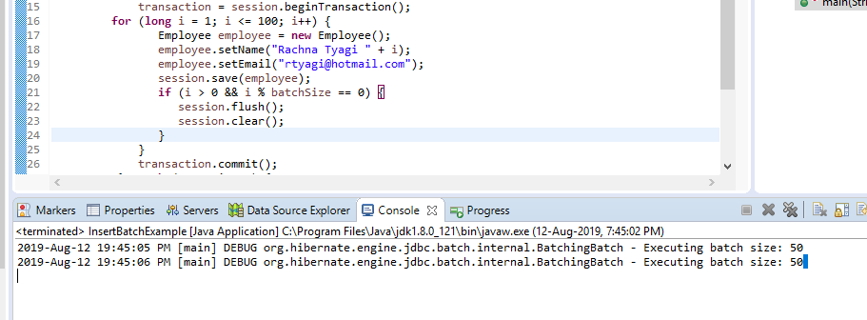
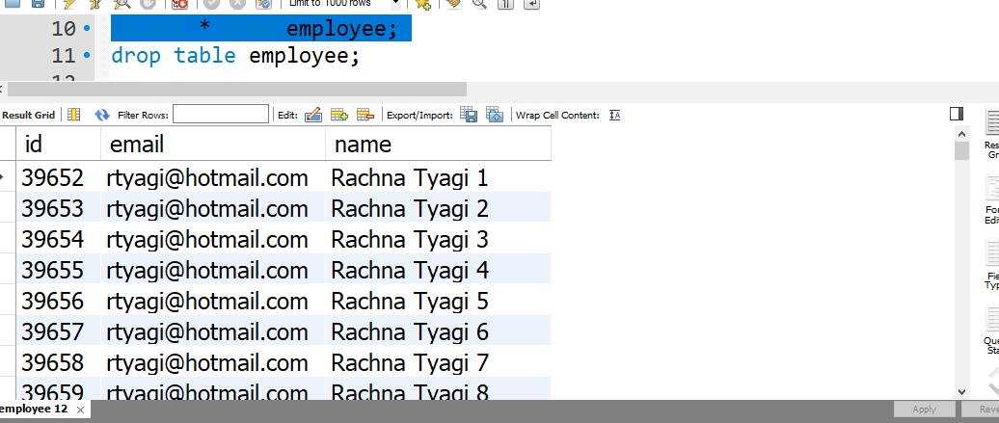
Demo: Batch Processing Cont..
To run the Hibernate application, Right click on the InsertBatchExample.java class -> Run As -> Java Application. We get following output on console
Open mysql workbench and type select * from employee we see 100 entries for customer

Slide 49
Interceptors
The Interceptor interface provides callbacks from the session to the application and can be used to inspect and/or manipulate properties of a persistent object before it is saved, updated, deleted or loaded.
It is used to track auditing information.
It is used to inspect the changes in entity’s property values before they are written and after they are read from a database.
It is used to perform the various operations such as logging, auditing, profiling etc.
There are two kinds of interceptors:
Session-scoped
Session-Factory scoped
Session-scoped interceptors
They are used when a Session is opened.
Below code snippet shows the how to add an interceptor to a Session.
Session session = HibernateUtil.getSessionFactory()
.withOptions()
.interceptor(new LoggingInterceptor())
.openSession();
Notes:
Refer https://docs.jboss.org/hibernate/orm/5.0/userguide/en-US/html/ch12.html

Slide 50
Interceptors Cont..
SessionFactory-scoped
They are used when SessionFactory is configured .
They are applied to all Session opened from that SessionFactory.
Below code snippet shows the how to add an interceptor to a SessionFactory.
SessionFactory sessionFactory = metadata.getSessionFactoryBuilder()
.applyInterceptor(new LoggingInterceptor())
.build();
Most basic methods that an Interceptor implements:
onSave : Called when you save an object. The object is not persisted yet.
onFlushDirty : Called when you update an object. The object is not persisted yet.
onDelete : Called when you delete an object.
preFlush : Called before committing to the database.
postFlush : Called after committing to the database.

Slide 51
Transaction Management
A Transaction is a sequence of Operation which performed with database.
Transactions Properties:
Atomicity
Consistency
Isolation
Durability
Transaction Properties are also called ACID Property.
RealWorldExample:
think of an example which applies on all of us
i.e. Transferring Amount from one account to another as this operation includes the below two steps:
Now think a situation where the amount is deducted from sender’s account but is not delivered to receiver’s account due to some errors.
Such issues are managed by the transaction management where both steps are performed in a single unit. In the case of a failure, the transaction should be roll-backed.
Transaction
completed
commit
Initial State
begin
Transaction
Transaction
failed
Roll back

Slide 52
ACID
ACID
Atomicity: Either all operations can be done, or all operation can be undone
Consistency: This means maintaining consistency in the datastore after a transaction is completed successfully.
Isolation: Isolating each transaction from one another without effecting each.
Durability: Once a transaction is completed, the data in the datastore will be permanent until any other transaction performed on that data.

Slide 53
ACID Cont..
Transactions Interface
They define the unit of work and maintain the abstraction from the transaction implementation (JTA, JDBC). Associated with Hibernate Session, a transaction is instantiated when we call the sessionObj.beginTransaction().
Below are the methods of Transaction interface:
Name | Description
begin() | It starts a new transaction.
commit() | It ends the transaction and flushes the associated session.
rollback() | It rolls back the current transaction.
setTimeout(int seconds) | It set the transaction timeout for any transaction started by a subsequent call to begin() on this instance.
isActive() | It checks if this transaction is still active or not.
wasRolledBack() | It checks if this transaction roll backed successfully or not.
wasCommitted() | It checks if this transaction committed successfully or not.

Slide 54
Transaction Management
Non-managed environment i.e. standalone, simple Web- or Swing applications
If a persistence layer of Hibernate runs in a non-managed environment then database connections are mostly handled by simple (i.e., non-DataSource) connection pools from which Hibernate gets connections as needed. Then session or transaction handling code can be as below:
Transaction transObj = null;
Session sessionObj = null;
try {
sessionObj = HibernateUtil.buildSessionFactory().openSession();
transObj = sessionObj.beginTransaction();
//Perform Some Operation Here
transObj.commit();
} catch (HibernateException exObj) {
if(transObj!=null){
transObj.rollback();
}
exObj.printStackTrace();
} finally {
sessionObj.close();
}
Notes:
Refer https://docs.jboss.org/hibernate/orm/4.2/manual/en-US/html/ch13

Slide 55
Summary
In this Module, we have learnt the following:
Annotations
Query Language
Criteria Queries
Native SQL
Caching
Batch Processing
Interceptors
Transaction Management

Slide 56

Thank You

